Slide 1
Hello Friends
Ian Mulhern
John Connelly
Mike York

Slide 2
Goals
Our Original Goal: Calculate Advanced Metrics from This year’s Masters Tournament
Our Achieved Goal: Pulled data from OMDB, Spotify, and Yelp API’s, each with unique objectives and visualizations

Slide 3
Issues We Faced
Difficulty connecting to API’s
Finding python library for Spotify API and figuring out how to use it
Hard to avoid using HTTP requests more than good practice dictates
When to use functions and when not to

Slide 4
Calculations
Using Spotipy platform for Spotify API (Program)
Found my top 20 favorite artists for short, medium, and long term parameters.
Found top 40 favorite songs for each term, then matched song artists to my top artists for matches
Took frequencies of top artist and top song appearances to build 3 Pie charts, displaying my popular artists who also made songs that I loved

Slide 5
Cont.
Using Yelp’s Fusion API, we were able to calculate the 20 restaurants in Ann Arbor with both the most reviews and their respective ratings
Using the location_query function, this calculation could be performed with any inputted keyword and location
One way to improve this function would be to add more optional API parameters that could make the search more specific, such as zip code and business ID
Only 20 items of data collected at a time, used an offset parameter within the API that allows you to iterate through the next pages of data

Slide 6
Cont.
Using the OMDB API,
We found the top 50 grossing films for 2017 and 2018 and added them to our database
Then calculated the amount of films in each genre in the top 50 for each year
One problem faced was that many films were labeled as multiple genres, so the frequencies do not add up exactly to 100, but rather show how many films were labeled in that genre

Slide 7
Visualizations

Slide 8
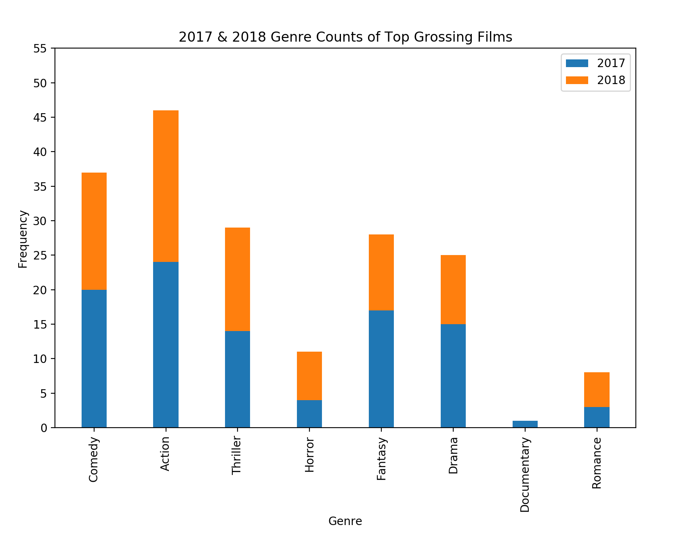

Slide 9
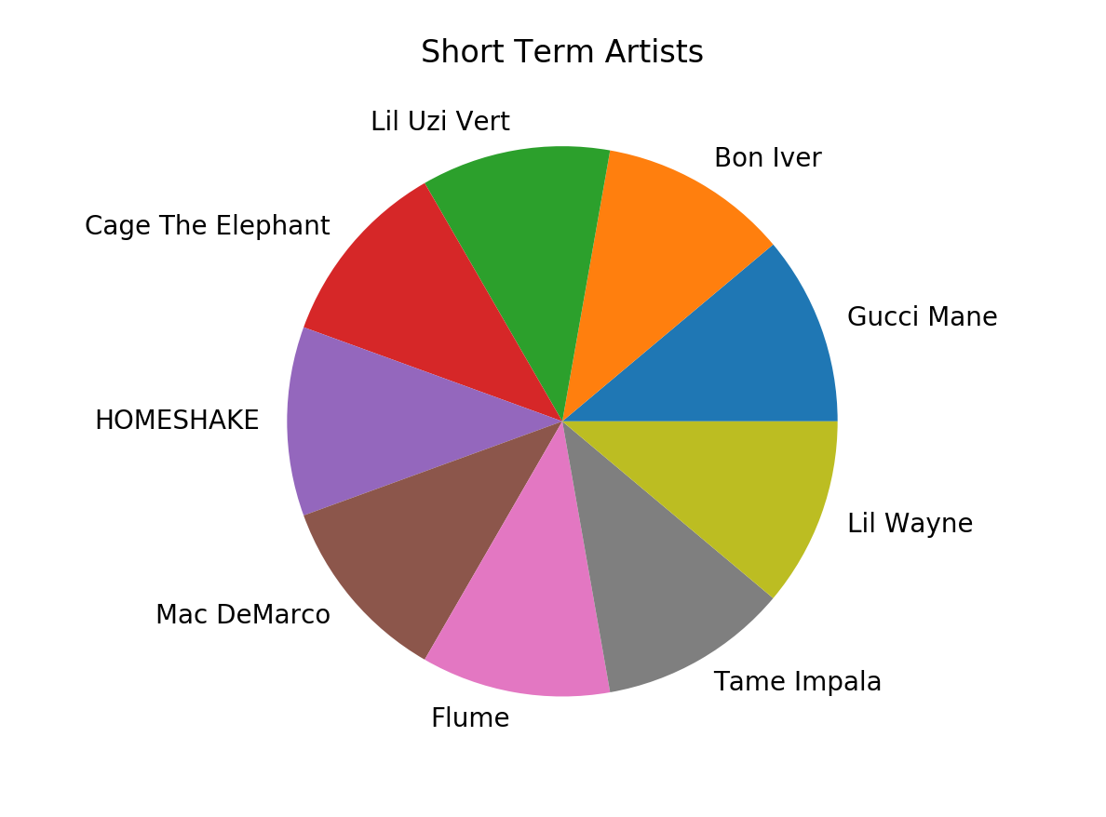

Slide 10
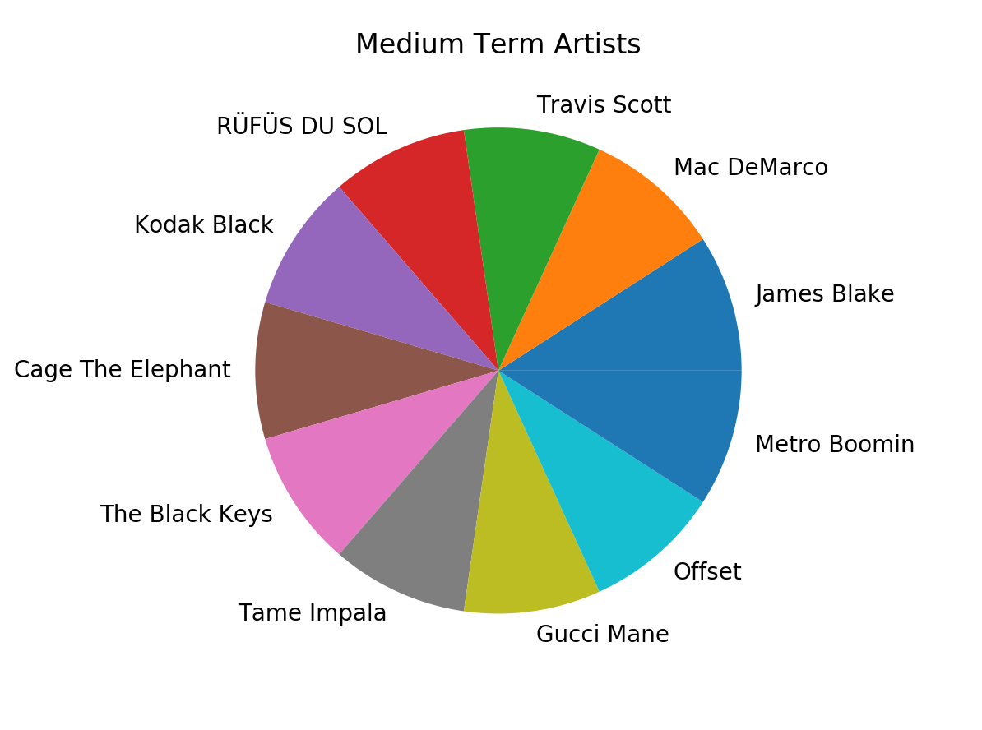

Slide 11
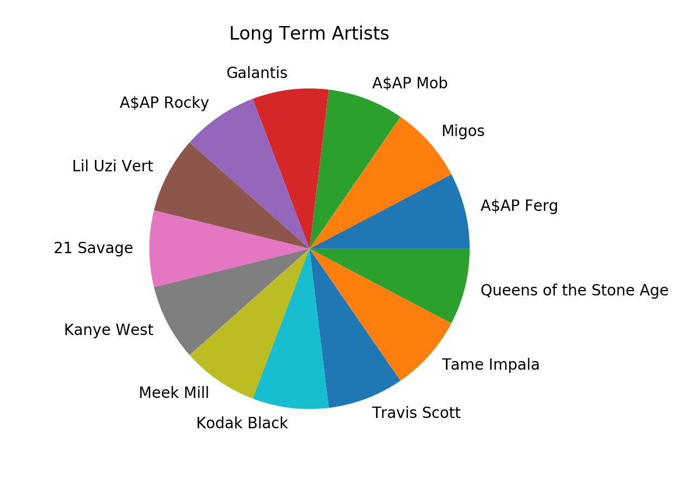

Slide 12
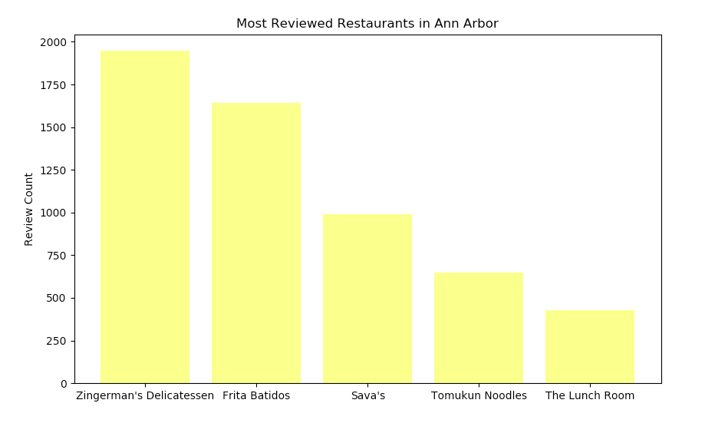

Slide 13
How to Run Our Code
Thing you must import:
from urllib.request import urlopen
Import numpy as np
from bs4 import BeautifulSoup
import ssl
import unittest
import sqlite3
import requests
import json
import sys
From urllib.parse import quote
import os
import spotipy
import webbrowser
import spotipy.util as util
import matplotlib
import matplotlib.pyplot as plt

Slide 14
Documentation
For OMDB:
get_omdb function takes no input and makes a request to the omdb api. It is a different request for each film title and the output is a list of tuple with each tuple containing the title, genre, and rating.
We then added the data to the databases using two different tables: one with the titles of the films and one with the genres, year, and ratings
Insert_titles function: insert_titles: no input, but goes about inserting data into the names table
Insert_movie_data function: no input, but creates a table with title_id, genre, rating, year
Then we do our calculations by going through our data from the movie data tables and count how many time each genre pops up in each year
to_json_file function takes in a json file name and writes data to said file. It has no output.
We then create our visualization

Slide 15
Documentation
Spotify:
The program starts by using sys to prompt the terminal for a spotify username, mine happens to be ian.mulhern0106
I then fill the token credentials to make a request to the API
The first thing printed is the general JSON data regarding my spotify account
Next I accumulate the most listened to artists for each time period (spotify has short, medium and long periods built into the parameters) and add them to respective lists
Next I find the most listened to tracks for each period and add them to respective dictionaries
From here, I take the song dictionaries and turn them into lists of the artists that made the songs. I then check these lists with the most popular artist lists and add them to a frequency dictionary if that artists happens to be within my top 20 artists overall for the time period.
I then take the data and add them to a table called spotify in our DB
I then pull the data from the db, and format it into lists that can then be visualized
Finally, I create 3 pie chart renderings of my most popular artists who also had my favorite songs for each time period

Slide 16
Documentation
For Yelp:
Program starts with a request function that connects to Yelp API, passing in base url and using the requests library to return a json formatted response
This function is used in the location query function, which passes in paramaters specific to the API (term, location, offset) to return json data for any inputted keyword and location
For the purposes of this project, this function is called to find data about restaurants in Ann Arbor
This data is used to calculate the 20 Ann Arbor restauants with the most reviews, and sorts their review counts and ratings
Next, this data is inserted into the project database
Using this data, a visualization is created of the top 5 restaurants with the most reviews
FInally, the json data is written to a json file

Slide 17
Resources
Stack Overflow
Youtube
W3 Schools
Peers

Slide 18
Resources
Date | Issue | Location | Result
4/20 | SQlite3 | HW9, SI206 | Resolved
4/18 | Spotify API Problem | Spotipy | Resolved
4/16 | Bar Graph Visualization | Stackoverflow | Resolved
4/15 | Pie Chart Labeling | Matplotlib Site | Resolved

